Slide 1

TITANIC

Slide 2
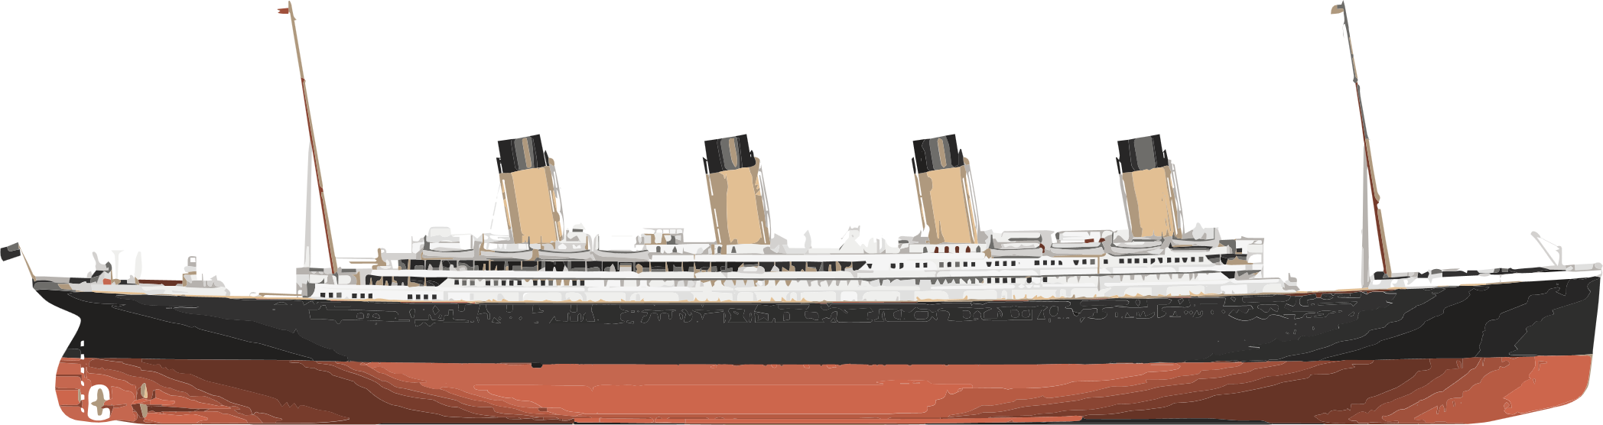
ABOUT the titanic
The “practically unsinkable” ship was originally stated to be one of the largest water based transports of its time. With an overall length of 882.75 feet and 7 decks, it was a marvel.
2200
1912
Ranging between various social classes with about 1379 male passengers and 678 female passengers
It was already ahead of competitive luxury ships in its time.
People Approximately
year

Slide 3
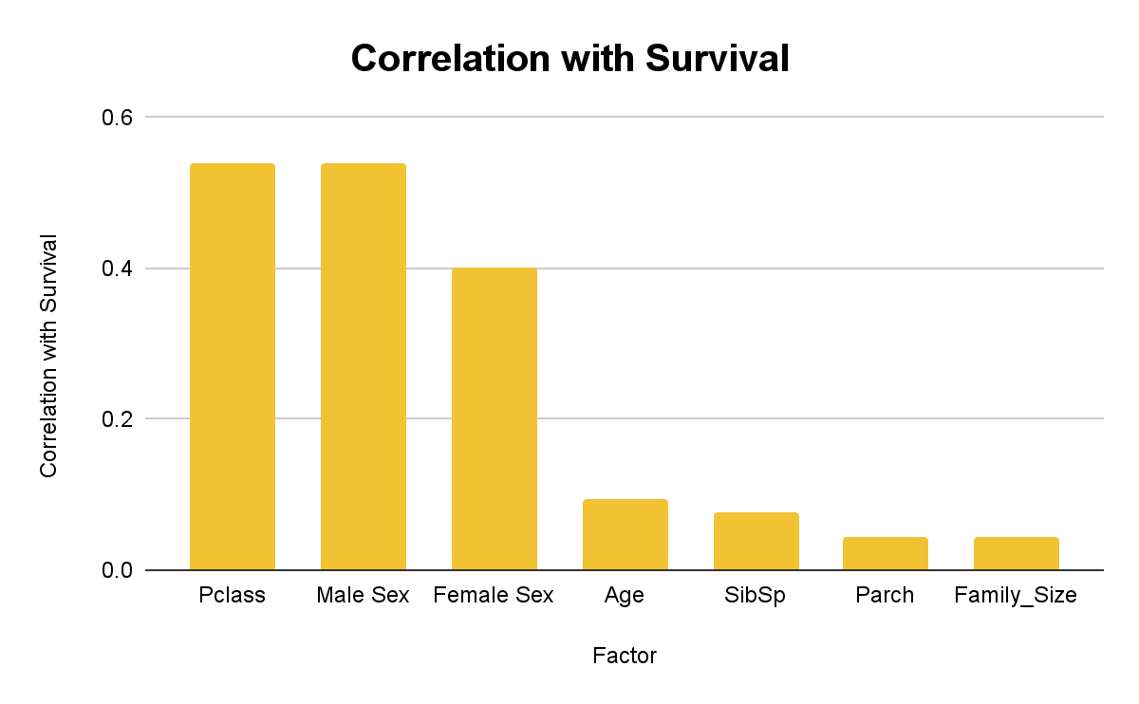
The Logistic Regression Model
1
Original dataframe was only slightly modified to drop N/As and certain non-numeric columns
Model
2
New dataframe was created with factors that were relatively more highly correlated with survival
Model

Slide 4
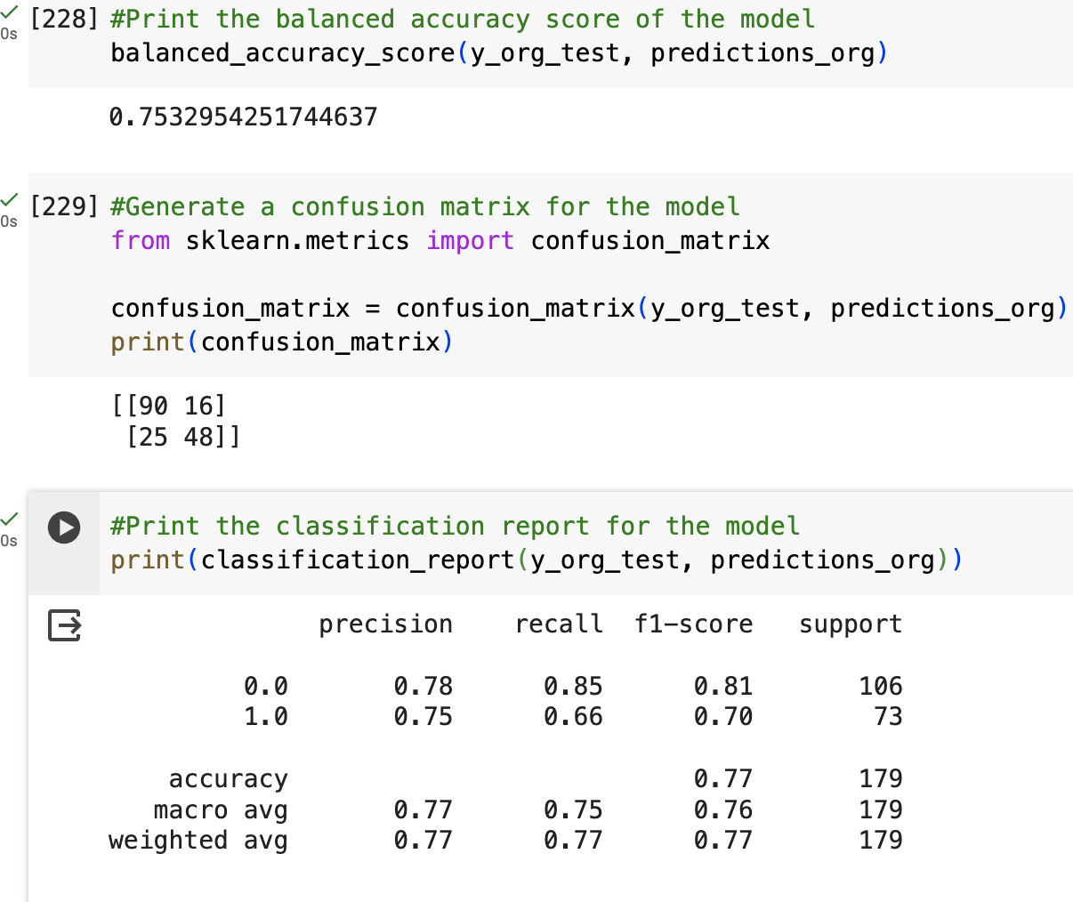
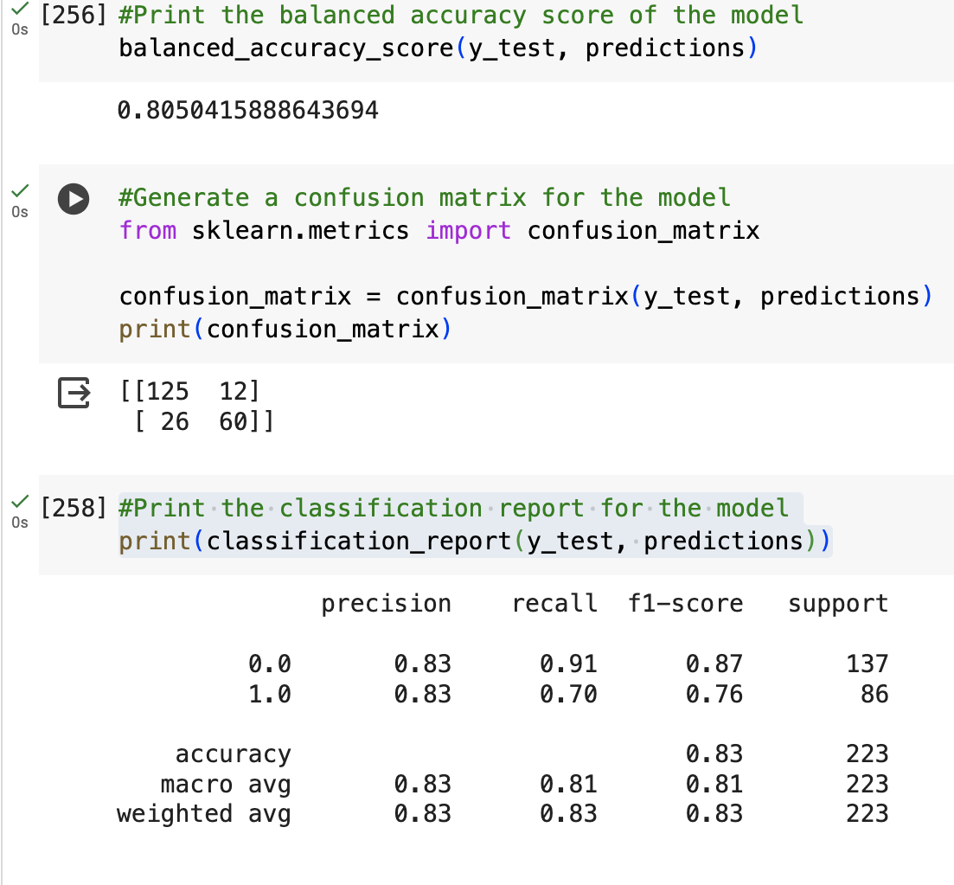
LR Model Performance
Model 1
Model 2
Notes:
*Might be significant to note that I tried to resample the data to remove the skew of one group dominating the other, but it only served to lower the model’s performance; open to future exploration that’s beyond the scope of this project

Slide 5
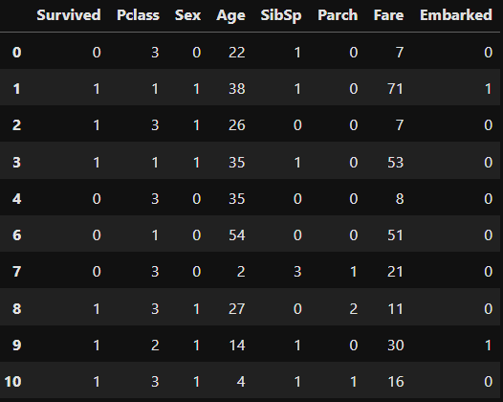
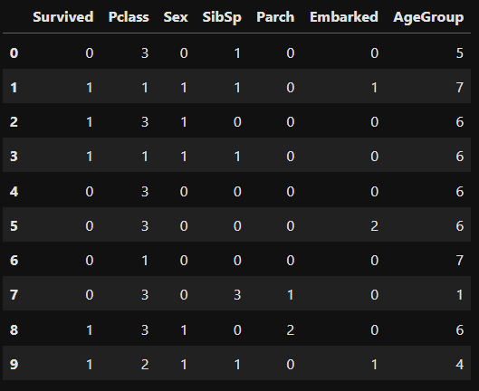
The Random Forest Model
1
2
Preparation:
Dropped missing values
Dropped non-numerical features
Preparation:
Filled missing values
Categorized features
Model
Model

Slide 6
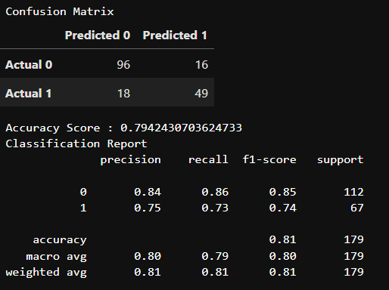
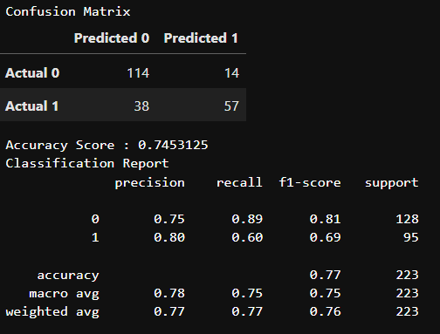
Random Forest Evaluation
Model 1
Model 2
Notes:
*Might be significant to note that I tried to resample the data to remove the skew of one group dominating the other, but it only served to lower the model’s performance; open to future exploration that’s beyond the scope of this project

Slide 7
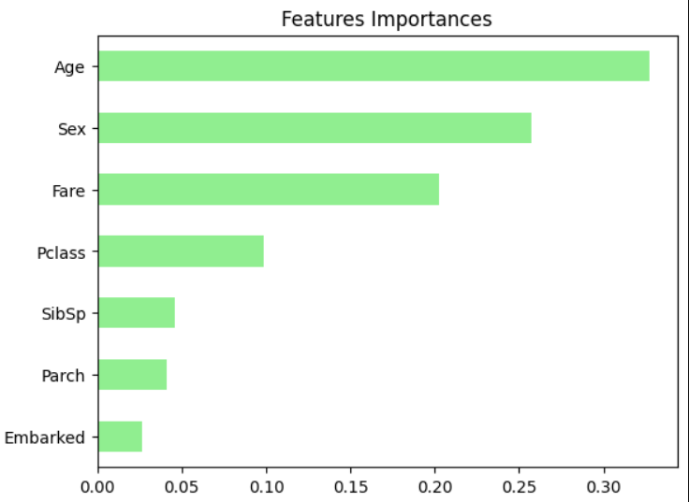
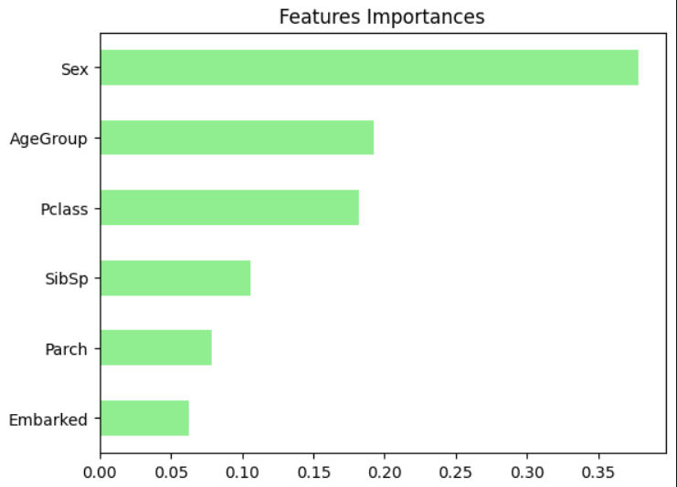
Random Forest
Feature Importance
Model 1
Model 2
Notes:
*Might be significant to note that I tried to resample the data to remove the skew of one group dominating the other, but it only served to lower the model’s performance; open to future exploration that’s beyond the scope of this project

Slide 8
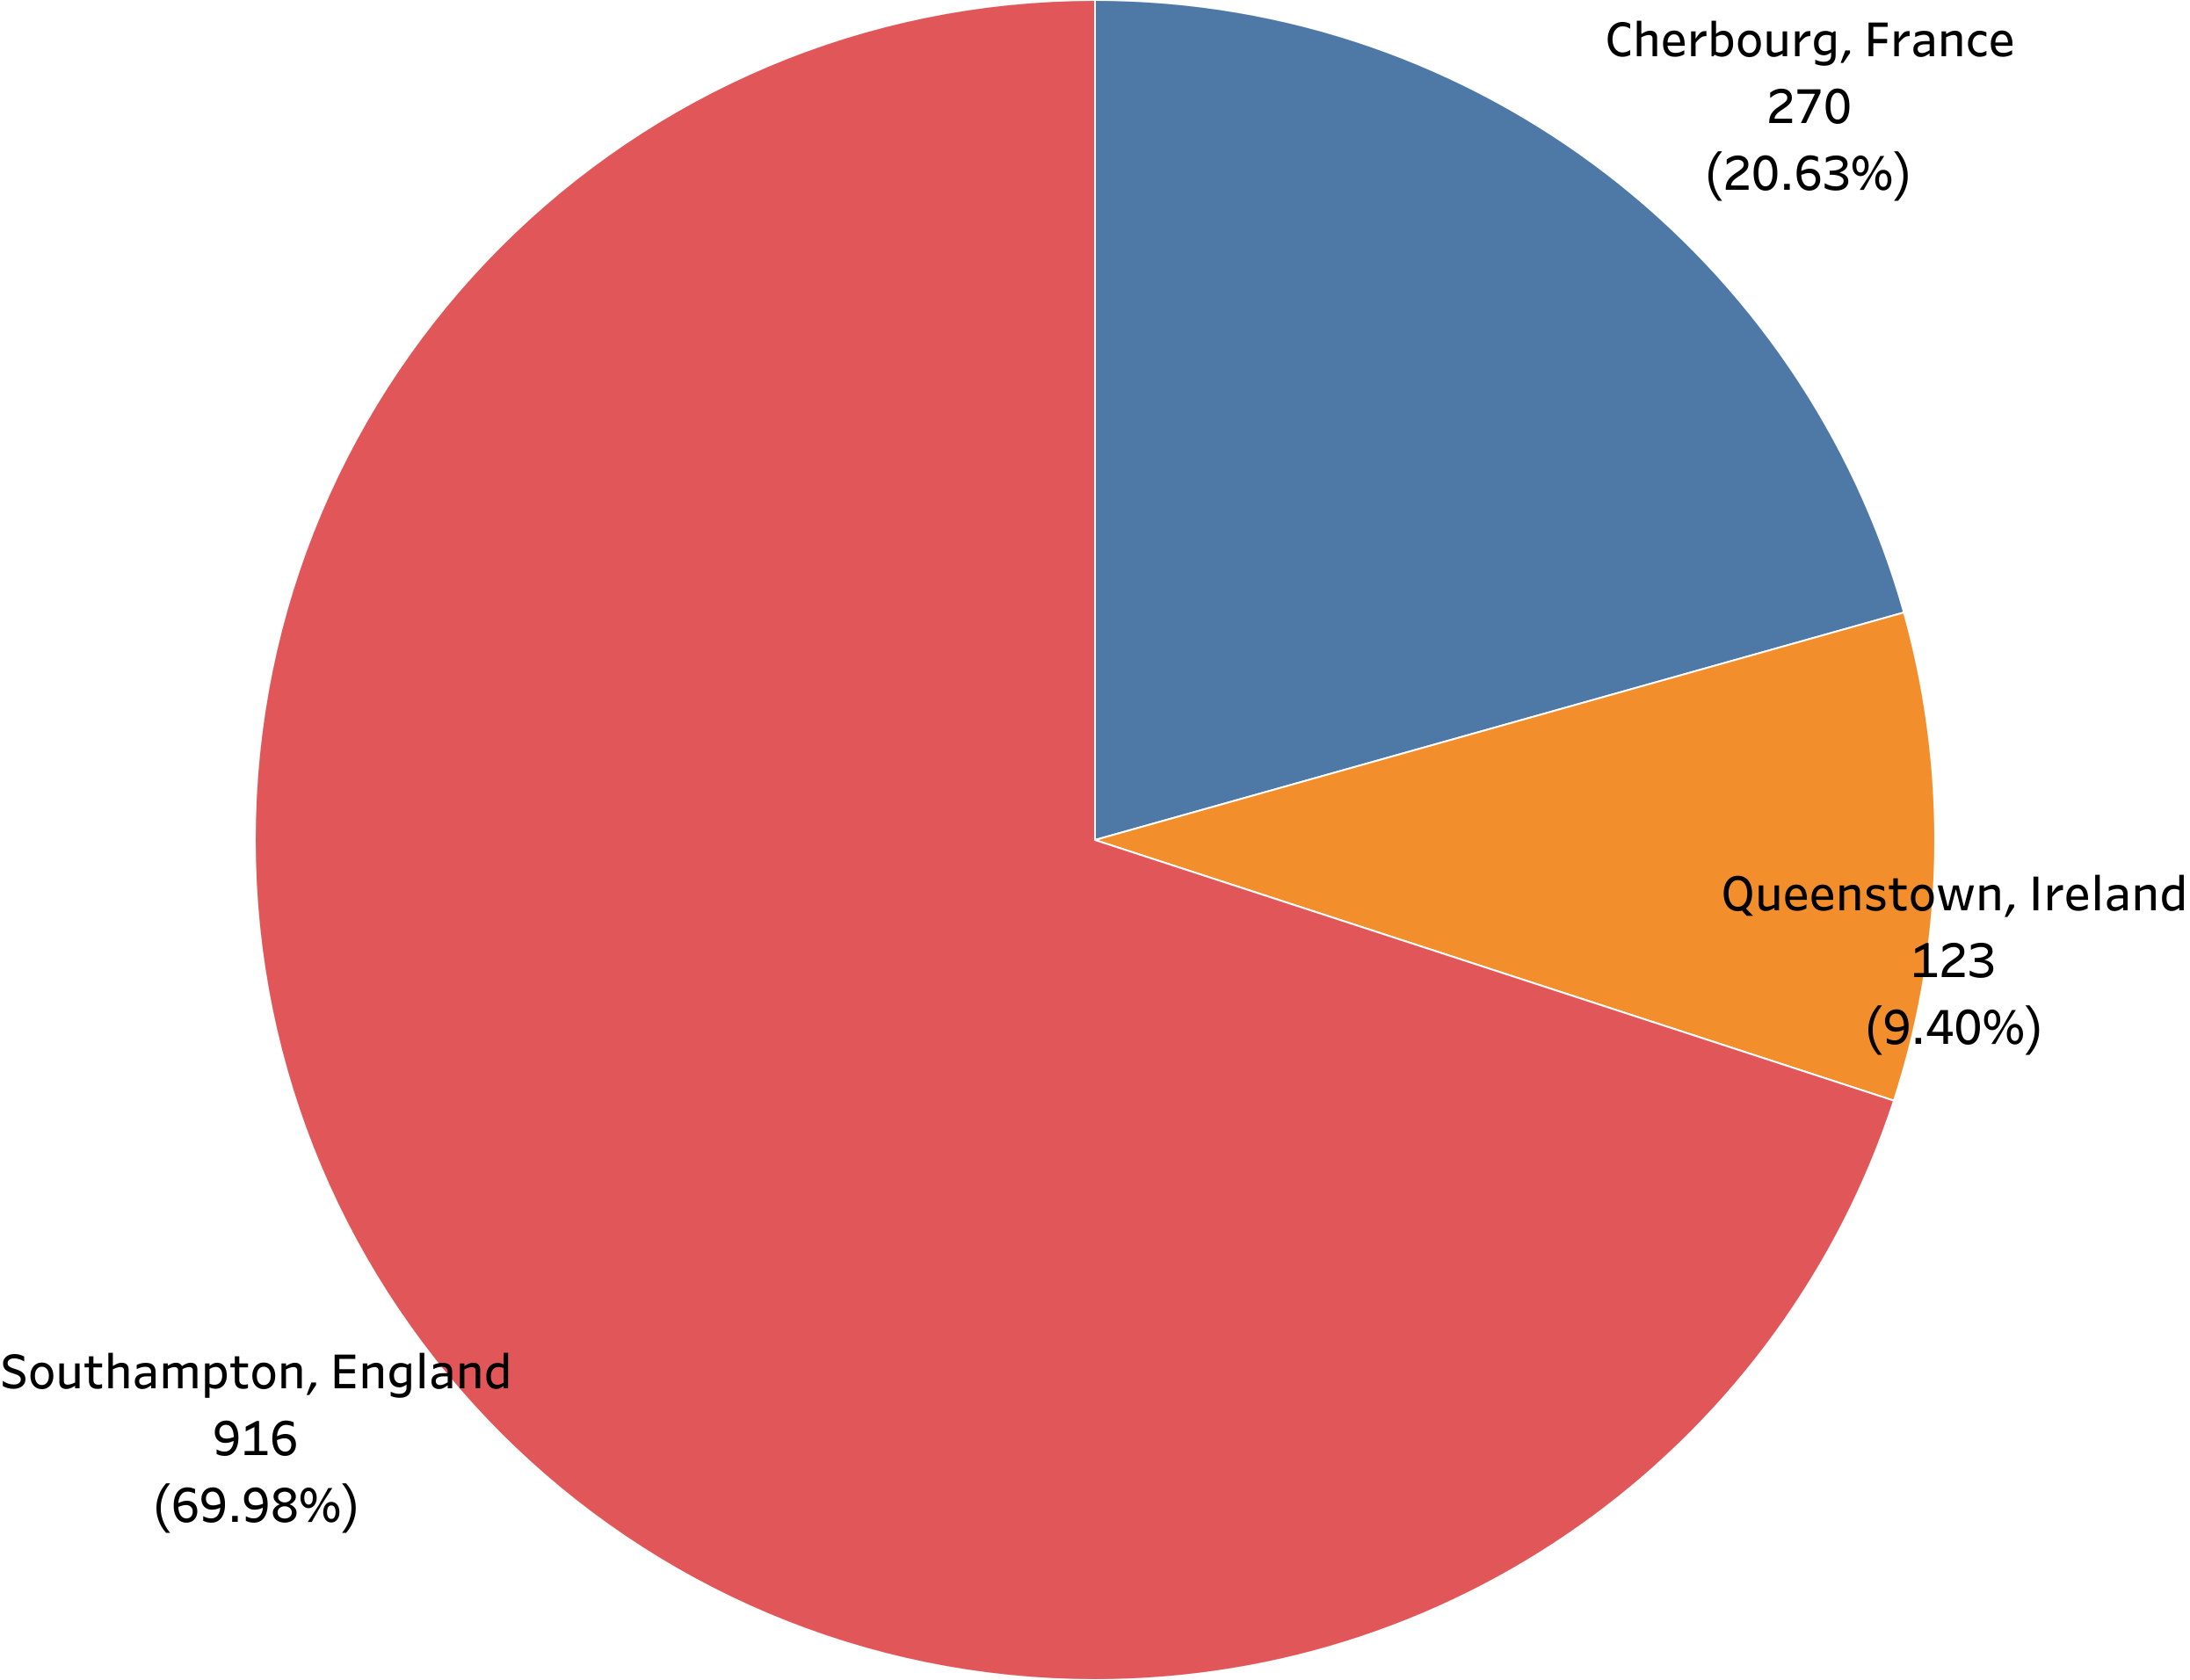
PORTS OF EMBARKATION
queenstown
Southhampton
cherbourg
Notes:
Insert Levars embark map here

Slide 9
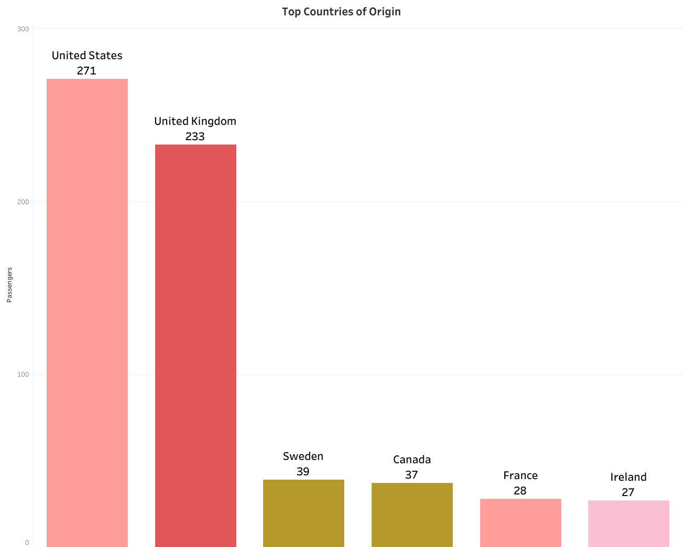
HOME COUNTRIES
Passengers came from around the world
563 Uncategorized persons in the dataset
Notes:
Insert Levars embark map here

Slide 10
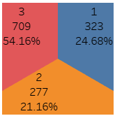
Passengers on board
3rd class
1st class
54% of passengers were in third class
25% of passengers were in first class
2nd class
21% of passengers were in second class

Slide 11
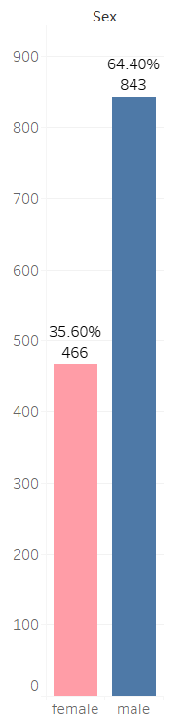
Passengers on board
Not including crew, there were 466 women on board and 843 men.

Slide 12

Who do you think made it to a lifeboat?
PollEv.com​/cameronwilso563

Slide 13
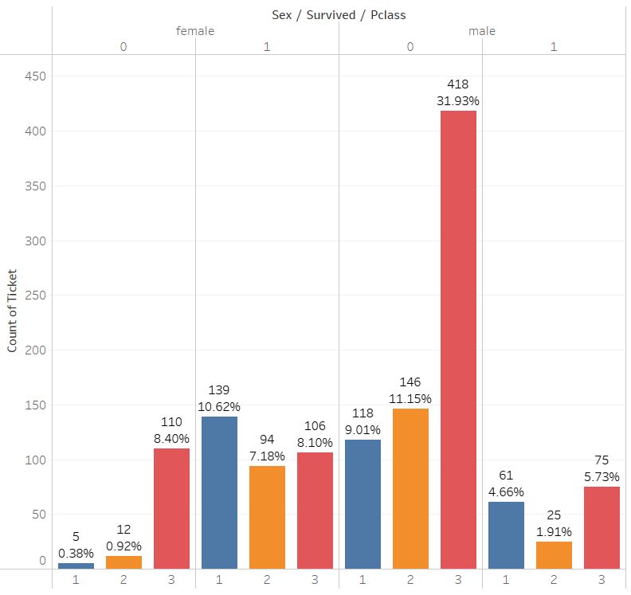
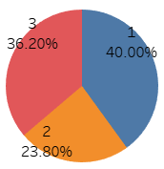
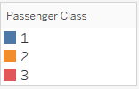
Survived (1) / Deceased (0) breakdown
Survivors by Passenger Class

Slide 14
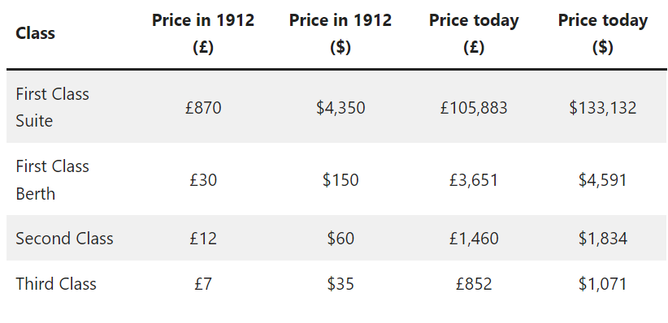
Titanic ticket prices
Image reference: https://www.cruisemummy.co.uk/titanic-ticket-prices/
Notes:
This slide here just to reference cost and get the audience thinking about which class would they have been in on the Titanic.

Slide 15
Where would you stand?

Slide 16
THANKS

